Slide 1
ATOMIC ENERGY EDUCATION SOCIETY
Distant Learning Programme
Class XI Subject: Physics
Chapter 1: Physical World(Module 1/1)
Contents :
Meaning & various branches of physics.
Physics in relation to society
Fundamental forces of nature.
Fundamental Conservation laws of nature i.e. Energy Conservation, Momentum Conservation,& Angular Momentum Conservation.

Slide 2




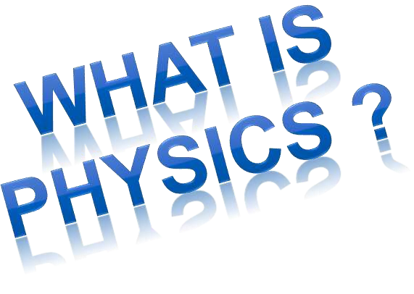

Slide 3

A way of describing the physical world
-Physics comes from the Greek “physis” meaning “nature” and the
Latin “physica” meaning natural things
Physics is understanding the behavior and structure of
matter
It deals with how and why matter and energy act as they do
Energy is the conceptual system for explaining how the
universe works and accounting for changes in matter
Although energy is not a “thing” three ideas about energy are important
  It is changed from one form to another (transformed) by physical events
  It cannot be created nor destroyed (conservation)
  When it is transformed some of it usually goes into heat

Slide 4



















Thermodynamics
– Heat and temperature
Mechanics
–Motion and its causes
Optics – Behavior of light
Branch in PHYSICS
Electromagnetism
– Electricity, magnetism and EM waves
Vibrations and Waves – Periodic motion
Nuclear – Structure of the nucleus, energy associated with nuclear changes
Atomic – Structure of the atom, energy associated with atomic changes

Slide 5









Slide 6

Physics - the study of matter, energy and their interactions - is an international enterprise, which plays a key role in the future progress of humankind. The support of physics education and research in all countries is important because:
Physics is an exciting intellectual adventure that inspires young people and expands the frontiers of our knowledge about Nature.
Physics generates fundamental knowledge needed for the future technological advances that will continue to drive the economic engines of the world.
Physics contributes to the technological infrastructure and provides trained personnel needed to take advantage of scientific advances and discoveries.

Slide 7

Physics is an important element in the education of chemists, engineers and computer scientists, as well as practitioners of the other physical and biomedical sciences.
Physics extends and enhances our understanding of other disciplines, such as the earth, agricultural, chemical, biological, and environmental sciences, plus
astrophysics and cosmology - subjects of substantial importance to all peoples of the world.
Physics improves our quality of life by providing the
basic understanding necessary for developing new instrumentation and techniques for medical
applications, such as computer tomography, magnetic resonance imaging, positron emission tomography, ultrasonic imaging, and laser surgery.

Slide 8



Slide 9






Slide 10
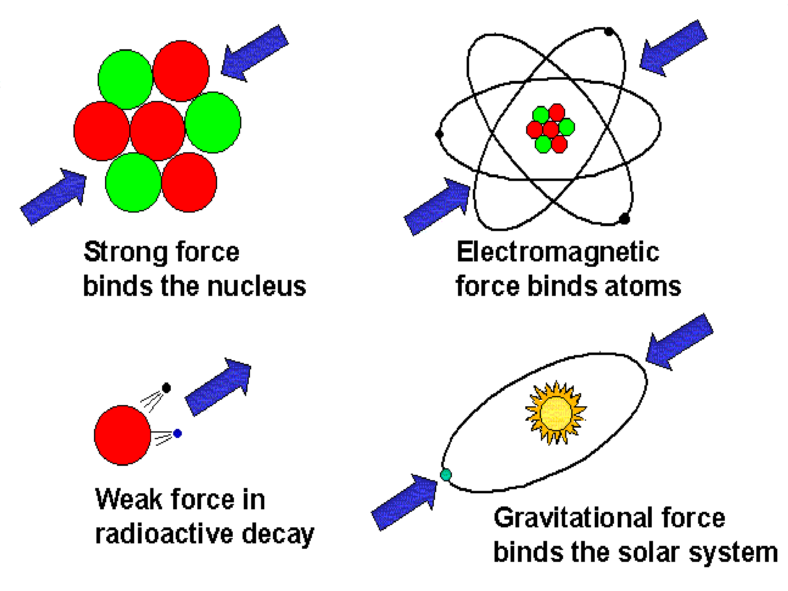


Slide 11



Slide 12

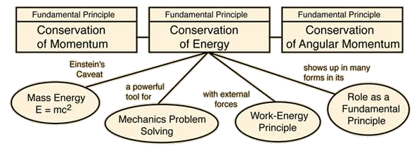

Slide 13

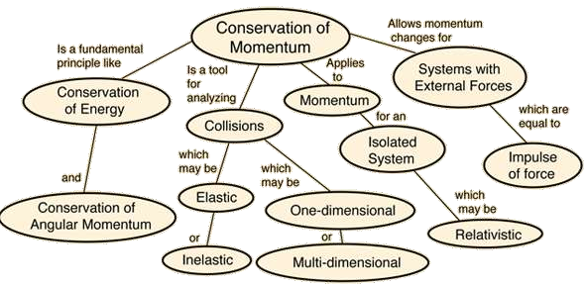

Slide 14

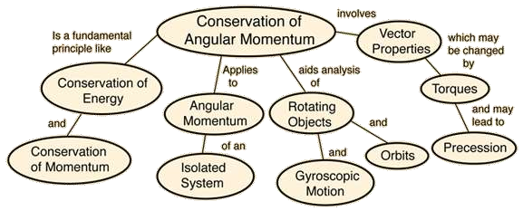

Slide 15
References :
NCERT XI class
Wikipedia Concept of physics by H C Verma
By: Govind Sharma
PGT (Physics)
AECS 4, Rawatbhata

